Slide 1
Power Finance Challenge
Power Payoff
Data-Driven Decision Making

Slide 2
Power Finance Challenge
The city of Solville is building a new solar-thermal power plant.
You have been hired by Mayor Whartenburger and the CFO of the city to make recommendations about what insulation materials to use when they build their power plant.

Slide 3
Power Finance Challenge
Recommendation to City
Expenses
Revenue
Profit
Break-Even Point
Your team must consider the following variables when making your recommendation.
  Expenses: The total amount of money it will cost you to provide the products or services
  Revenue: The amount of money you earn by selling the good or services
  Profit: The amount of money you earn after all expenses have been paid
  Break-Even Point: The point in time when you have spend the same amount of money as you have earned.

Slide 4
Power Finance Challenge
Simulations: Used because we need to understand how the insulations will affect the plant, and to be able to calculate our financial information.
Go to the following site to run the computer simulation:
ampitup.gatach.edu/simulations

Slide 5
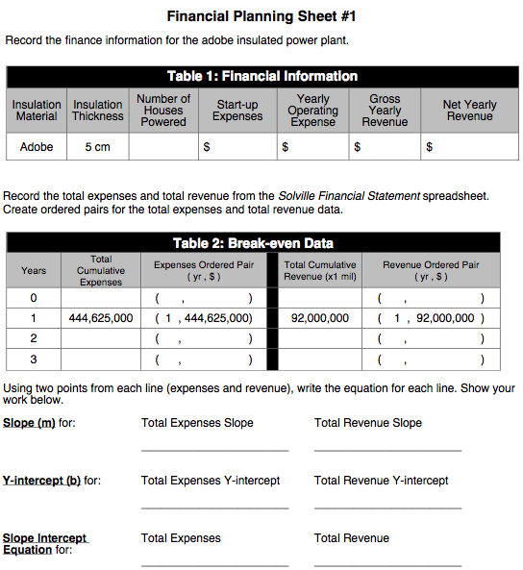
Power Finance Challenge
Run the simulation for 5cm of Adobe
  Connect the power
  Record the number of homes it powers on Financial Planning Sheet #1 (remember its x1000)
  Click “Calculate Expense”
  Record start-up expense and annual operating expense in Table 1 on Financial Planning Sheet #1

Slide 6
Power Finance Challenge
Calculate Gross Yearly Revenue:
  Gross Yearly Revenue= Number of Houses x $1000
Calculate Net Yearly Revenue:
  Net Yearly Revenue= Gross Yearly – Yearly Operating Expenses

Slide 7
Power Finance Challenge
Solville Financial Statement: (Enter the following on the sheet)
Insulation Material
Insulation Thickness
Number of Houses Powered

Slide 8
Power FINANCE CHALLENGE

Slide 9
POWER FINANCE CHALLENGE
Notes:
Be sure that students are putting in the information into its correct location, then finish out the bottom of Table 2.

Slide 10
Power Finance Challenge
Find the equations on Financial Planning Sheet #1.
Transfer this to the Break-even System of Equations sheet.
Complete Break-even System of Equations sheet.

Slide 11
Power Finance Challenge
Using the same procedure as before, determine which other insulation materials is able to power 120,000 homes.
- Record your data on Financial Planning Sheet #2

Slide 12
Power Finance Challenge
Your will now be assigned a specific insulation material and thickness combination
You/ Your group should determine the break-even point for that design.
- Data and Analysis should be recorded on Financial Planning Sheet #2.

Slide 13
Power Finance Challenge
Share out your teams data. Record on Financial Planning Sheet #2

Slide 14
Power Finance Challenge
How can the information you gathered be used to make an informed recommendation about the power plant? Consider the following:
Use the decision making matrix to better visualize/ compare your data:

Slide 15
Power Finance Challenge
Use the coding provided in the Student Book to color each consideration according to its color value.
Make your final recommendation
Consider:
How the loan will impact Solville for extra fees.
How the time to pay back impacts the overall plan.
How much profit will the city be able to do?
Notes:
Students will need to color code the matrix according to the guide provided within the student text. This will ultimately provide the visual that they will use to write their final recommendation letter.

